Slide 1
Potential energy landscapes identify the information-theoretic
nature of the epigenome
4 mar 2021

Slide 2
whole-genome bisulfite sequencing
Determine TAD boundaries using methylation data
Human cells from several healthy organs and organs with cancer

Slide 3
Split everything into 150bp units

Slide 4
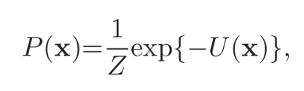

1D Ising Model from statistical physics

Slide 5

Determine the parameters using blackbox multilevel coordinate search (MCS) algorithm
3-kb regions (20 units), M - sequencing reads in the region

Slide 6

where Q (Nl) is the set of all methylation patterns with exactly Nl methylated CpG sites
probability distribution of methylation level

Slide 7
Informational Shennon entropy
normalized methylation entropy
Between 0 and 1; max value when all methylation levels
within a genomic unit are equally likely (fully disordered state) regardless of the number of
CpG sites
minimum value only when a single methylation level is
observed (perfectly ordered state)

Slide 8
Classify 150bp units
ordered (0 ≤ h ≤ 0.44),
weakly ordered/disordered (0.44 ≤ h ≤ 0.92),
disordered (0.92 ≤ h ≤ 1)

Slide 9
Sliding window: 500 units (75kb)
>= 75% ordered -> ordered
>= 75% disordered -> disordered

Slide 10
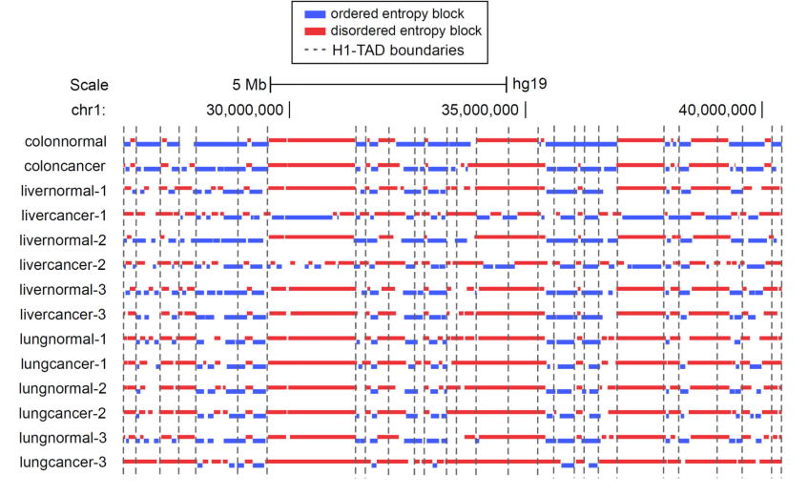

Slide 11
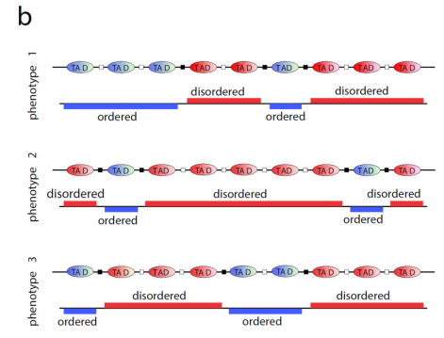

Slide 12
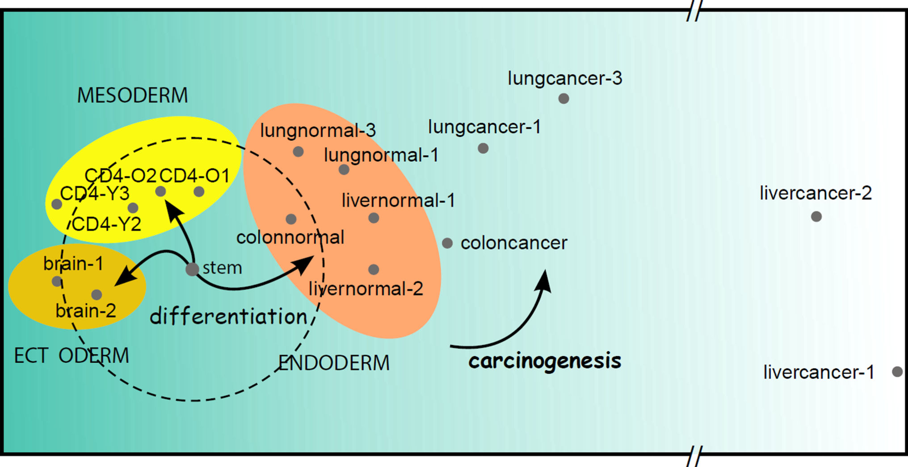

Slide 13
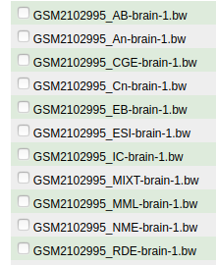
https://github.com/GarrettJenkinson/informME
It is required to properly configure a MATLAB C++ mex compiler.

